Slide 1
Coronavirus Dataset Analysis
This presentation covers the importance of data analysis in understanding the impact of COVID-19. It covers the description of the dataset, tools and libraries used, data loading, and cleaning, along with detailed explanations and code snippets for SQL queries to retrieve information such as total cases, death rates, and recovery rates by country. The presentation also includes visualization of results for better understanding of the data. The conclusion summarizes the key insights from the analysis and reiterates the importance of data-driven decision making.
Make by : Karan patel

Slide 2
Coronavirus Dataset Analysis
To solve the SQL queries, I used pandas and pandasql libraries in Python

Slide 3
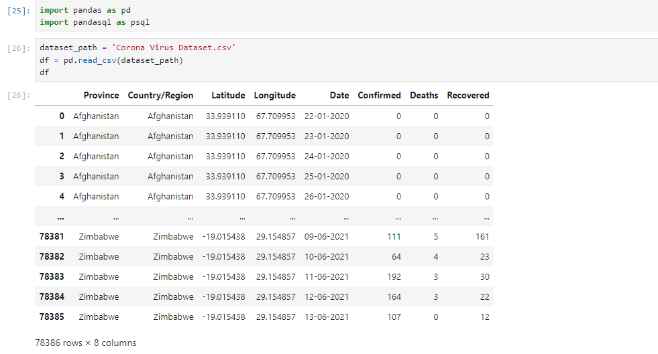
Import library and add csv file

Slide 4
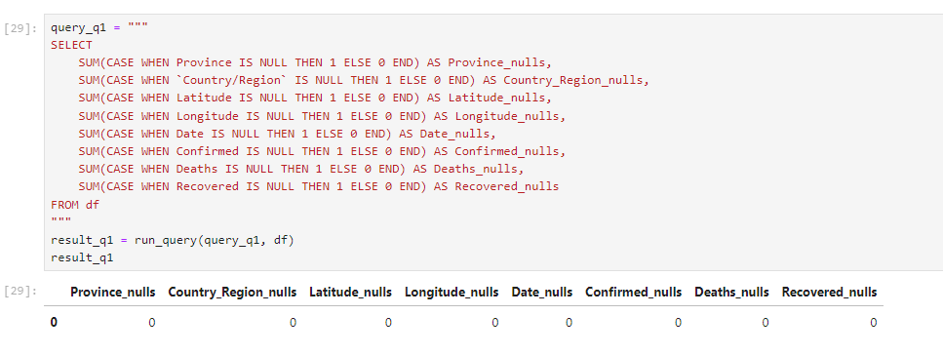
Query :- 1
Q1. Write a code to check NULL values
This query is designed to assess the quality of our dataset by identifying any NULL values present in each column. It uses a series of SUM and CASE statements to count the occurrences of NULL values across all columns. This step is crucial in data analysis as it helps us understand if there are any gaps in our data that might affect the accuracy of our results. By running this query, we ensure that our dataset is complete and ready for further analysis.

Slide 5
Query :- 2
If NULL values are present, update them with zeros for all columns.
Q2: Update NULL Values with Zeros Based on the results of the first query, we know that there are no NULL values in any of the columns in the dataset. Therefore, there is no need to execute query number 2, which would replace NULL values with zeroes.
now we move on the 3ed query

Slide 6
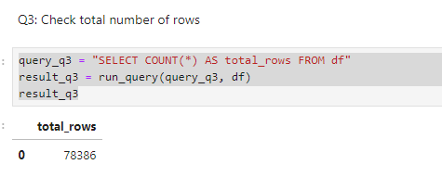
Query :- 3
check total number of rows
This straightforward query uses the COUNT(*) function to determine the total number of rows in our dataset. Understanding the size of our dataset is fundamental as it gives us an idea of the scope of our data and can influence our analysis methods. In this case, we found that our dataset contains 78,386 rows, providing a substantial amount of data for our COVID-19 analysis.

Slide 7
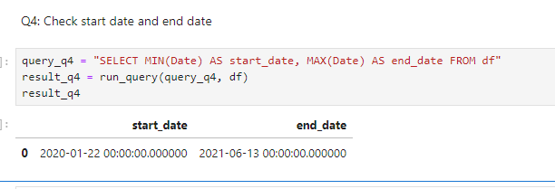
Query :- 4
Check what is start_date and end_date
This query utilizes the MIN() and MAX() functions on the Date column to identify the earliest and latest dates in our dataset. By running this query, we discovered that our data spans from January 22, 2020, to June 13, 2021. This information is crucial as it defines the time frame of our analysis and helps us understand the period of the pandemic that our data covers.

Slide 8
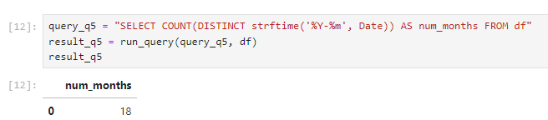
Query :- 5
Q5. Number of month present in dataset
This query counts the number of distinct year-month combinations in our dataset using the strftime function to extract year and month from the Date column. The result showed that our data covers 18 months. This information helps us understand the temporal granularity of our data and ensures we have a consistent monthly representation throughout our analysis period.

Slide 9
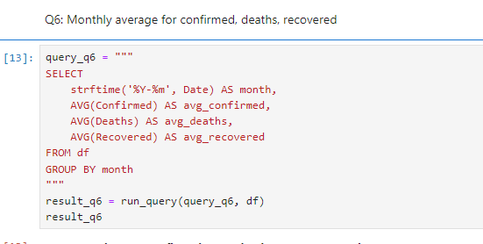
Query :- 6
Q6. Find monthly average for confirmed, deaths, recovered
This query calculates the average number of confirmed cases, deaths, and recoveries for each month in our dataset. It groups the data by year and month using the strftime function and then applies the AVG() function to each of the relevant columns. This analysis provides valuable insights into the monthly trends of the pandemic, allowing us to see how the average daily numbers changed over time. It can reveal patterns such as waves of infections or improvements in recovery rates as the pandemic progressed.

Slide 10
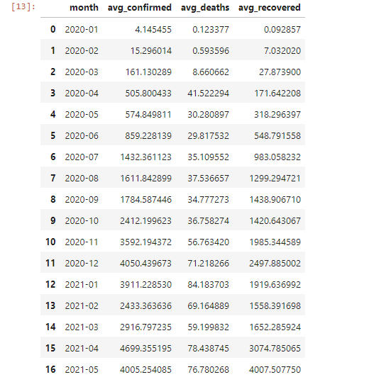

Slide 11
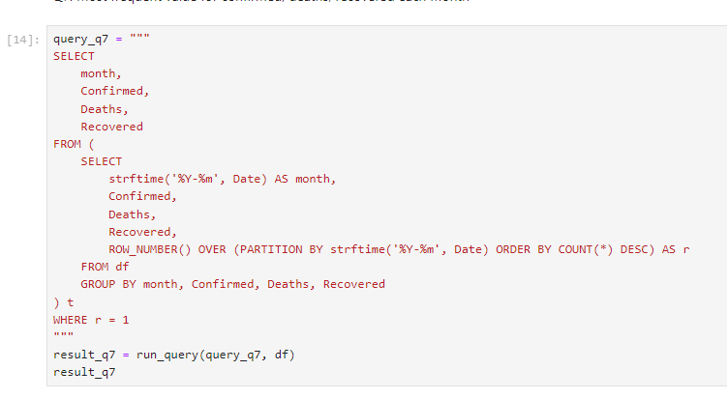
Query :- 7
Q7. Find most frequent value for confirmed, deaths, recovered each month

Slide 12
This complex query finds the most common combination of confirmed cases, deaths, and recoveries for each month. It uses a subquery with ROW_NUMBER() to rank these combinations within each month based on their frequency. The outer query then selects only the top-ranked (most frequent) combination for each month. This analysis helps identify the most typical scenario for each month of the pandemic, which can be particularly useful for understanding the 'normal' state of affairs in different phases of the pandemic.

Slide 13
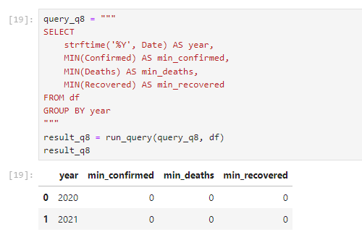
Query :- 8
Q8. Find minimum values for confirmed, deaths, recovered per year
This query finds the minimum number of confirmed cases, deaths, and recoveries for each year in our dataset. It groups the data by year and applies the MIN() function to each of the relevant columns. This analysis shows us the lowest points of the pandemic each year, which can be indicative of periods of effective control or lulls between waves of infection. Comparing these minima across years can also give us insight into how the baseline of the pandemic changed over time.

Slide 14
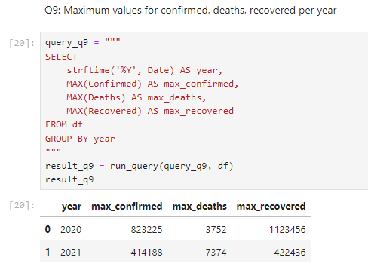
Query :- 9
Q9. Find maximum values of confirmed, deaths, recovered per year
Similar to Query 8, this query finds the maximum number of confirmed cases, deaths, and recoveries for each year. It uses the MAX() function instead of MIN(). This analysis reveals the peak numbers for each year, indicating the worst periods of the pandemic. Comparing these maxima across years can show how the intensity of the pandemic changed, and whether control measures or other factors affected the peak numbers over time.

Slide 15
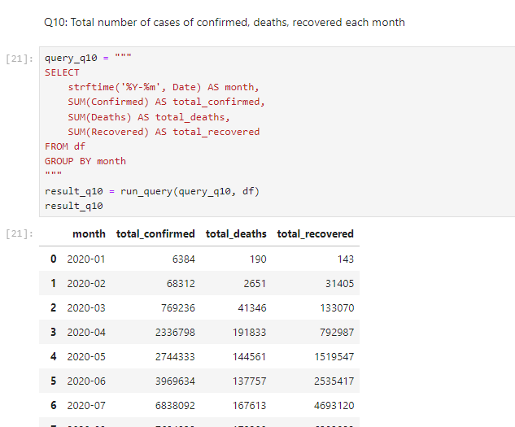
Query :- 10
Q10. The total number of case of confirmed, deaths, recovered each month
This query calculates the total number of confirmed cases, deaths, and recoveries for each month by grouping the data by year and month and applying the SUM() function to each relevant column. This provides a clear picture of the monthly progression of the pandemic, showing how the total impact changed from month to month. It can reveal overall trends, such as whether the pandemic was generally worsening or improving over time.

Slide 16
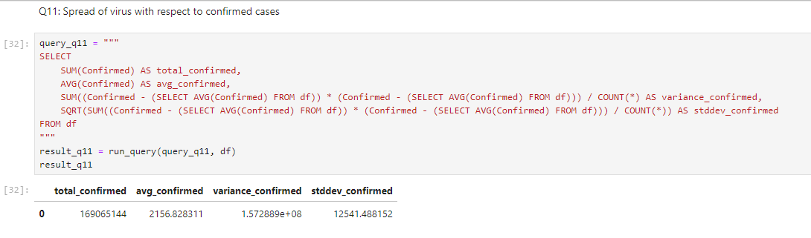
Query :- 11
Q11. Check how corona virus spread out with respect to confirmed case
This query calculates overall statistics for confirmed cases, including the total, average, variance, and standard deviation. It uses subqueries to calculate the global average for variance computation. These statistics provide insights into the overall spread and variability of confirmed cases. The variance and standard deviation, in particular, show how much the number of confirmed cases typically deviated from the average, giving us a measure of the pandemic's inconsistency or unpredictability.

Slide 17
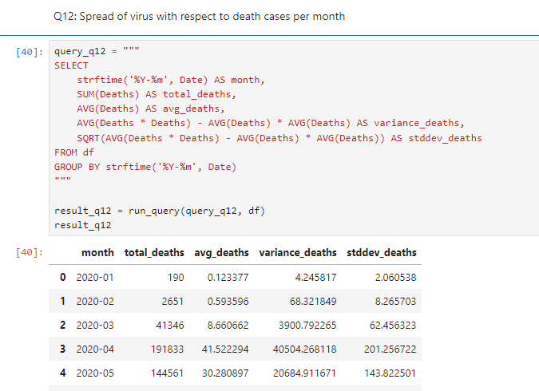
Query :- 12
Q12. Check how corona virus spread out with respect to death case per month
This query calculates monthly statistics for deaths, including total, average, variance, and standard deviation. It groups the data by month and uses a simplified formula for variance calculation. This analysis provides insights into how death rates fluctuated from month to month, showing periods of higher or lower variability in mortality. It can help identify months where death rates were more unpredictable or volatile.

Slide 18
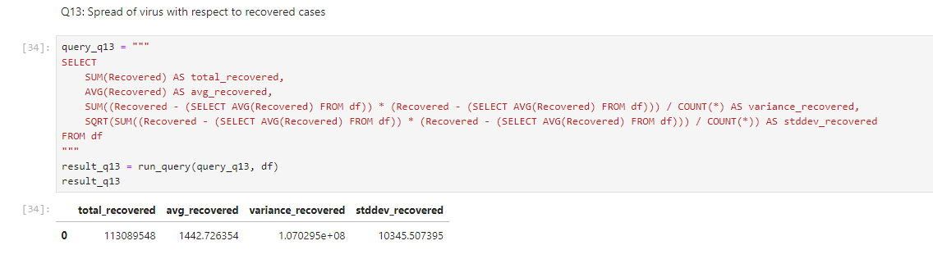
Query :- 13
Q13. Check how corona virus spread out with respect to recovered case
-- (Eg.: total confirmed cases, their average, variance & STDEV )

Slide 19
Similar to Query 11, this query calculates overall statistics for recovered cases. It provides the total, average, variance, and standard deviation of recoveries. This helps understand the spread and variability of recovery rates throughout the pandemic. Comparing these statistics with those from confirmed cases and deaths can give insights into the relationship between infections, recoveries, and mortalities.

Slide 20
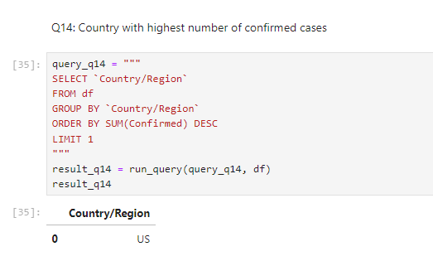
Query :- 14
Q14. Find Country having highest number of the Confirmed case
This query sums up confirmed cases for each country, orders them in descending order, and selects the top country (with the highest number of confirmed cases). It helps identify the most severely affected country in terms of total infections. In this case, the query revealed that the US had the highest number of confirmed cases, providing a global context to the pandemic's impact.

Slide 21
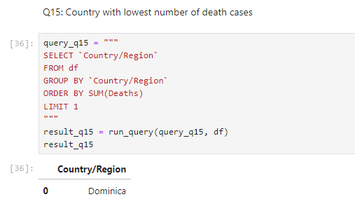
Query :- 15
Q15. Find Country having lowest number of the death case
Similar to Query 14, but this query sums up death cases and orders countries in ascending order to find the country with the lowest number of deaths. It identified Dominica as the country with the lowest death toll. This information can be valuable for understanding which countries may have been less severely impacted or may have had more effective strategies for preventing COVID-19 deaths.

Slide 22
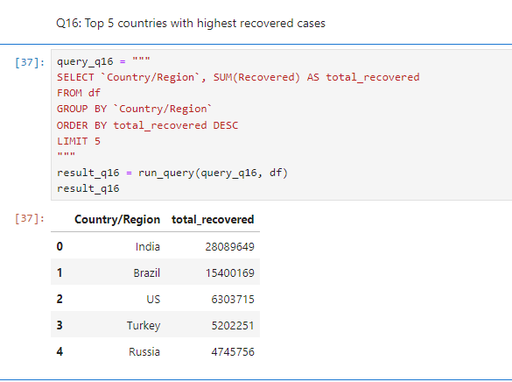
Query :- 16
Q16. Find top 5 countries having highest recovered case
This query sums up recovered cases for each country, orders them in descending order, and selects the top 5 countries with the highest number of recoveries. The results showed that India, Brazil, US, Turkey, and Russia had the highest numbers of recovered cases. This information can provide insights into which countries had the most successful recovery rates or the largest number of resolved cases, though it should be interpreted in the context of their total case numbers as well.

Slide 23
These queries collectively provide a comprehensive analysis of the COVID-19 dataset, covering data quality, temporal trends, country-wise comparisons, and statistical measures of the pandemic's spread. They offer valuable insights into various aspects of the pandemic, from global trends to country-specific impacts, and from overall patterns to monthly fluctuations.

Slide 24

Election Results-2024 Analysis with Power BI
Insights into Election Results, Party Performance, and Voter Trends
Presented By
Ravi Patel

Slide 25
Presentation Roadmap
01
02
03
Objectives
Data Description
Data Integration
04
05
06
Data Cleaning and Preparation
Dashboard Overview
Conclusion
Goals of the analysis
Overview of datasets
Combining data sources
Ensuring data quality
Interactive visualizations
(Include Dashboard Image)
Summary and implications

Slide 26

01
Objectives

Slide 27

The objective is to analyze the 2024 election data to gain insights into the election results, understand party performance and voter trends across various constituencies, and create interactive visualizations and dashboards for stakeholders.

Slide 28

02
Data Description

Slide 29
Election Results Data
id: Unique identifier for each record.
State: Name of the state.
Const. No.: Constituency number.
Constituency: Name of the constituency.
Leading Candidate: Name of the leading candidate.
Leading Party: Name of the leading party.
Trailing Candidate: Name of the trailing candidate.
Trailing Party: Name of the trailing party.
Margin: Vote margin between the leading and trailing candidates.
Status: Status of the election result (e.g., Won, Lost, Leading, Trailing).

Slide 30
Party Alliance Data
Party Name: Name of the political party.
Alliance Name: Name of the political alliance the party belongs to.

Slide 31

03
Data Integration

Slide 32

We combined the election results data with the party alliance data to form a comprehensive dataset. This integration provides a detailed view of which alliances are leading or trailing in various constituencies, allowing for a thorough analysis of political power distribution and voter preferences. This holistic approach offers valuable insights into the dynamics between political alliances and their impact on the election outcomes.

Slide 33


04
Data Cleaning and Preparation

Slide 34

Check Data: Identify and address missing values and inconsistencies.
Correct Errors: Fix errors to ensure dataset accuracy.
Prepare Data: Standardize column names and fill missing values.
Example: Correct column names and fill missing values for completeness.

Slide 35

05
Dashboard Overview

Slide 36

Interactive Dashboard: Created in Power BI to analyze the 2024 election data.
Filters: Explore data by state, constituency, party, alliance, and status.
Key Performance Indicators (KPIs): Total seats won, won margin, constituencies won by alliance.
Visualizations: Summarize overall results, state-wise performance, constituency-wise analysis, party and alliance comparison, trend analysis.

Slide 37
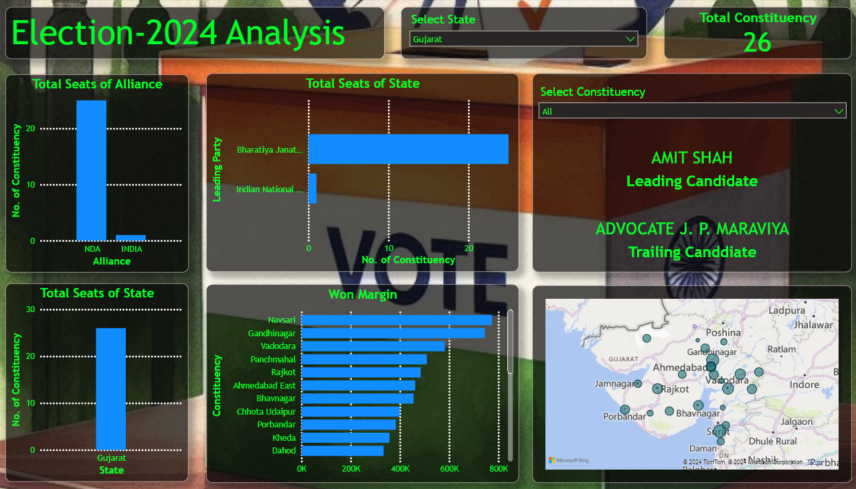
Dashboard Image

Slide 38

06
Conclusion

Slide 39

ADVERTISING CAMPAIGN 2
The analysis of the 2024 election data provides comprehensive insights into party performance and voter trends across constituencies. The interactive dashboard created in Power BI allows stakeholders to explore detailed election outcomes and dynamics between political alliances, aiding strategic decision-making for future elections.

Slide 40

THANKS

